Slide 1
Title IX and Bystander Intervention
Fall 2021
Presented by
Tricia Lovely
Title IX / EEO Coordinator

Slide 2
Introductions
Name
How long you’ve been at Shoreline
Burning questions about Title IX
Notes:
My name is Tricia Lovely. I prefer she/her pronouns. I’m the Title IX / EEO Coordinator. My role is to oversee the College’s response to reports of sexual misconduct and other forms of discrimination to protect the rights of students and employees to learn and work in an safe environment.

Slide 3
Today’s session
Title IX – The Basics
Responding to reports of sexual misconduct
Bystander intervention
Questions

Slide 4
Ground Rules
Show respect for others
Practice self-care
What is said in the training stays in the training
Ask questions!
Notes:
My name is Tricia Lovely. I prefer she/her pronouns. I’m the Title IX / EEO Coordinator. My role is to oversee the College’s response to reports of sexual misconduct and other forms of discrimination to protect the rights of students and employees to learn and work in an safe environment.

Slide 5
Title IX – The Basics
“No person in the United States shall, on the basis of sex, be excluded from participation in, be denied the benefits of, or be subjected to discrimination under any education program or activity receiving federal financial assistance.”
Education Amendments of 1972
Notes:
In other words, Title IX requires gender equity in all educational programs receiving federal funding. Title IX is often associated with athletics, because it began as way to ensure equal opportunities for male and female students to participate in athletic programs. It has since come to encompass every aspect of education in the United States.

Slide 6
What does it mean?
Title IX:
Prohibits gender discrimination
Prohibits sexual harassment
Prohibits sexual violence
Prohibits discrimination against pregnant and parenting students and employees

Slide 7
Definitions:
Gender Discrimination
Unfavorable treatment of a person based on that person’s sex, gender identity or expression, sexual orientation or pregnancy. Prohibited gender-based discrimination includes sexual harassment.

Slide 8
Definitions:
Sexual Harassment
A form of discrimination consisting of unwelcome, gender-based verbal, written, electronic and/or physical conduct.

Slide 9
Definitions
Sexual Harassment
Two types under Title IX:
1. Quid Pro Quo: A school employee conditioning the provision of an aid, benefit, or service of the school on an individual’s participation in unwelcome sexual conduct

Slide 10
Definitions
Sexual Harassment
2. Hostile Environment: Unwelcome conduct that a reasonable person would find to be so severe, pervasive, and objectively offensive that it effectively denies a person equal access to the College’s educational programs or activities or College employment.

Slide 11
Definitions:
Sexual Harassment includes acts of sexual violence, such as:
Nonconsensual sexual contact
Nonconsensual sexual intercourse
Domestic violence
Intimate partner (dating) violence
Stalking

Slide 12
Title IX Requires the College to:
Respond promptly and effectively when a possible Title IX violation becomes known
Provide interim supportive measures as needed
Investigate the claim
Ensure due process and fair treatment of all parties in our response
Provide remedies – take steps to ensure the situation doesn’t occur again
Protect all parties from retaliation

Slide 13
What is our role as employees?
As representatives of Shoreline CC, we support a culture of care for our students and each other
We commit to creating an environment in which sexual misconduct is unacceptable
We serve as mandated reporters

Slide 14
What does it mean to be a
mandated reporter?
If you witness or learn about sexual violence, sexual harassment or gender discrimination, you must report it to an appropriate authority.
We can protect an individual’s privacy, but we can’t promise confidentiality.
With the exception of Counselors,
we are all mandated reporters

Slide 15
How do I respond?
When someone discloses sexual misconduct
1. Determine if emergency services are needed (medical treatment or law enforcement response). If so, call Safety and Security or 911.
2. Help the person feel safe and supported.
3. Let them know that you may have to report what they tell you.

Slide 16
How do I respond?
When someone discloses that they or someone else have been subjected to sexual misconduct
Tell Michaela;
Contact the Title IX Coordinator directly: (titleixcoordinator@shoreline.edu); OR
Report online: www.shoreline.edu/title-ix

Slide 17
After you report a concern
The Title IX Coordinator contacts the affected party
Interim measures are arranged as needed
The Title IX Coordinator identifies the appropriate path to resolution
If a formal complaint is filed, responsibility will be determined by means of an investigation and hearing
Regardless of the path to resolution, you may never know the outcome.

Slide 18
Apply your knowledge!
Scenario:
A student comes to you in obvious distress. You ask what’s wrong and they tell you that something “bad” has happened, but you have to promise not to tell anyone.
What is the first thing you do?
The student decides to disclose to you that they were sexually assaulted last week.
How do you respond?

Slide 19
Bystander intervention…
When individuals take positive action in the face of injustice or when another person is in need of assistance.

Slide 20
Preparing to be an active bystander:
Develop awareness
Recognize and honor your own boundaries
Plan what you might do or say in different situations

Slide 21
Before intervening…
Always assess the situation! Ask yourself:
Is intervention needed? (If it were me or someone I love in this situation, would I want someone to help?)
Am I risking my safety if I intervene directly?
Am I risking the safety of the people involved if I intervene?
What strategy is most appropriate for the situation?

Slide 22
Intervention strategies:
DIRECT
Confront the person engaged in the behavior verbally
Ask the person who is being harmed if they need help
Engage other bystanders to help

Slide 23
Intervention strategies:
DISTRACT
Interrupt the situation without direct confrontation
Engage directly with the person who is being harmed – ask them for the time or for directions, pretend that you know them, etc.
Engage directly with the harasser – tell them their car is being towed, spill a drink on them, etc.

Slide 24
Intervention strategies:
DELEGATE
Turn to a third party for help
Tell the person “in charge” – in a restaurant or store, speak to the manager; on a bus, speak to the driver, etc.
Contact emergency services if appropriate

Slide 25
Apply your knowledge!
Scenario:
Two students are having a heated conversation. One student touches the other on the shoulder and the other student shoves the first student hard enough to make them lose their balance.
Is this a situation where you might intervene?
• What are the risks of intervening?
• What is the downside of NOT intervening?
• Do you decide to intervene? Which strategy do you use?

Slide 26
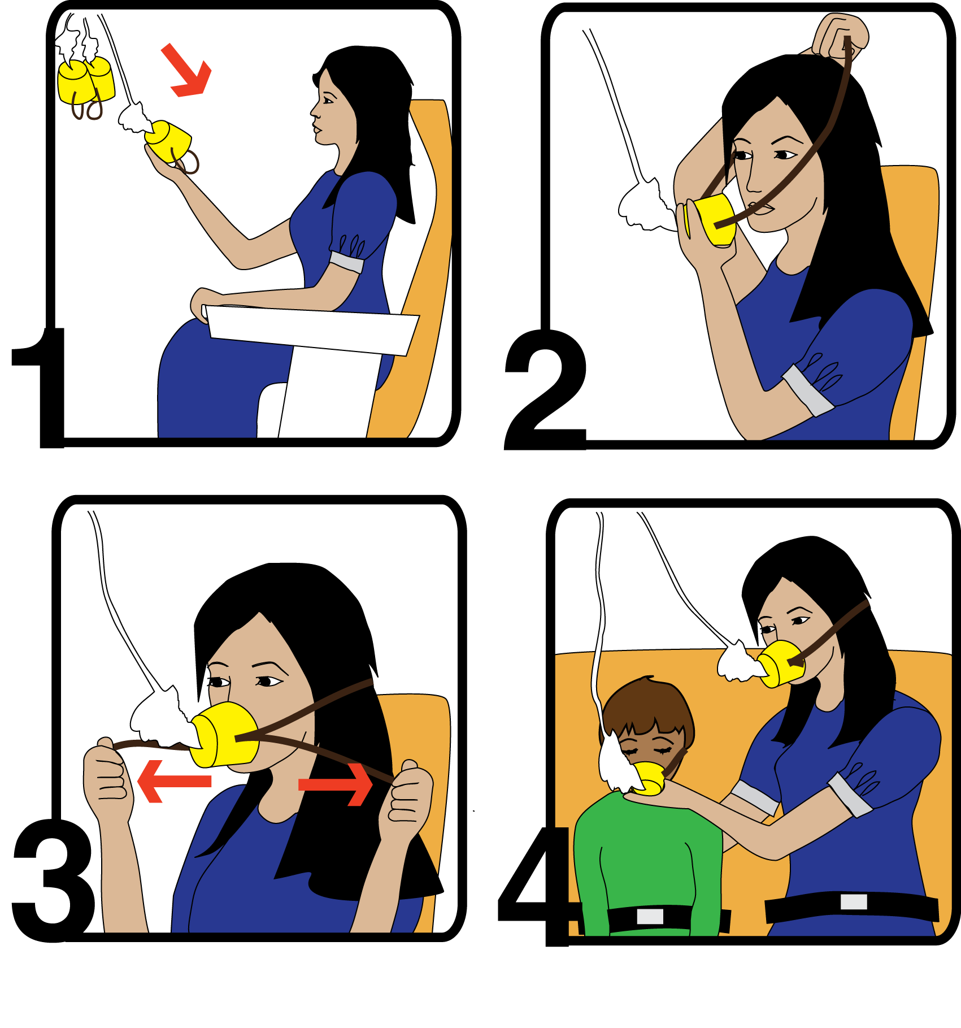
Take care of yourself!

Slide 27
Conclusion
What are your key takeaways from today’s training?
Is there anything else you would like to discuss today?

Slide 28
Learn more about Title IX:
Shoreline CC Title IX web page:
https://www.shoreline.edu/title-ix/
Know Your IX:
https://www.knowyourix.org
U.S. Department of Education: Title IX
https://sites.ed.gov/titleix

Slide 29
Learn More about Bystander Intervention
Step UP! Bystander Intervention Program:
https://stepupprogram.org
Hollaback! Bystander Intervention Training
https://www.ihollaback.org/bystander-resources
A Guide to Bystander Intervention. Southern Poverty Law Center on Campus (2017). https://www.splcenter.org/sites/default/files/soc_bystander_intervention_guide_web_final.pdf

Slide 30
Contacts
Tricia Lovely
Title IX/EEO Coordinator
tlovely@shoreline.edu
206-533-6746
Counseling Center
206-546-4594
Campus Safety and Security (24x7)
206-235-5860 (campus extension 4499)

Slide 31
Thank you for your time!

