Slide 1



Can You Taste That?
Predicting PTC Tasting Ability Among Non-Human Primates

Slide 2

What is “Bioinformatics”?
Bioinformatics is the application of computer science and information technology to biology and medicine.
National Institutes of Health Definition:
Research, development, or application of computational tools and approaches for expanding the use of biological, medical, behavioral or health data, including those to acquire, store, organize, archive, analyze or visualize such data.

Slide 3
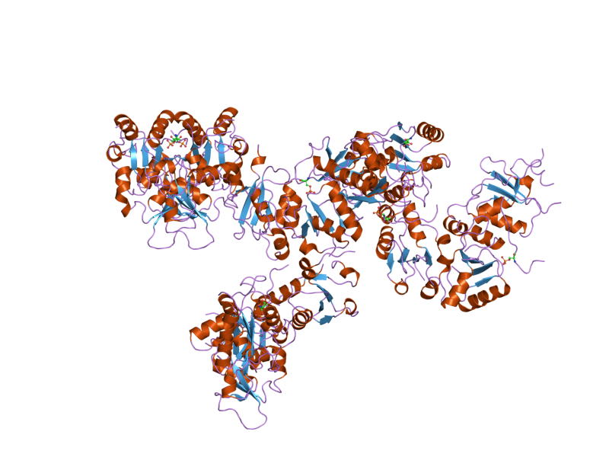
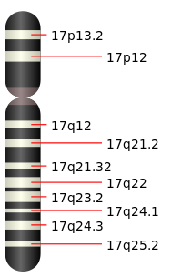
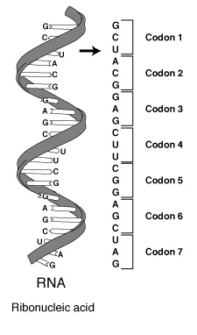
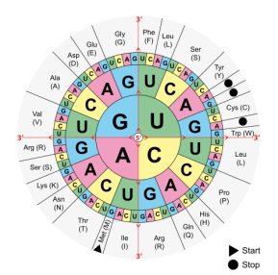
Bioinformatics Tools Help Scientists:
Organize, Process, and Make Sense of Complex Biological Data Sets
DNA
RNA
Protein
Bioinformatics Tools:
DNA Sequencing
Identify Mutations in DNA.
Bioinformatics Tools:
RNA Sequencing
Identify tissue specific gene expression.
Bioinformatics Tools:
Protein 3D Structure visualization.
Identify the impact of mutations.
Image Source: Wikipedia Commons
Notes:
Bioinformatics tools help scientists organize, process and make sense of complex biological data sets

Slide 4
TAS2R38 Bitter Taste Receptor [“PTC”] Gene
Left Primer
Chromosome 7
1002 bp
Right Primer
Amplify by PCR
NONTASTER (tt)
TASTER (TT)
GGCGGGCACT
GGCGGCCACT
PCR PRODUCT (221 bp)
Digest with
HaeIII Restriction Enzyme
(Recognition Sequence GGCC )
PCR PRODUCT (221 bp)
GGCGGGCACT
GGCGG
CCACT
Gel Electrophoresis
221 bp FRAGMENT
44 bp FRAGMENT
177 bp FRAGMENT
221 bp FRAGMENT
177 bp FRAGMENT
44 bp FRAGMENT
Source: Using a Single-Nucleotide Polymorphism to Predict Bitter-Tasting Ability. Dolan DNA Learning Center and Carolina Biologicals.

Slide 5
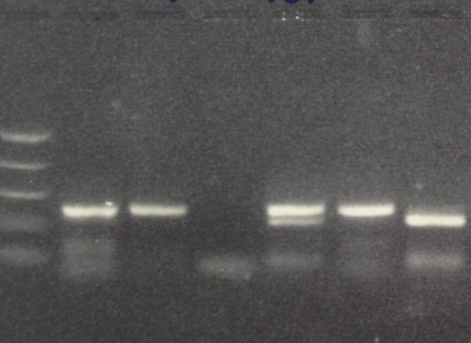

Can you taste that?
PTC Tasting & Polymerase Chain Reaction (PCR)
U = Undigested PCR Product
D = Digested PCR Product
Day 1: Isolating DNA
Day 2: Performing PCR
Day 3: Restriction Digest of PCR Product
Day 4: Agarose Gel Electrophoresis & PTC Tasting Paper
Day 5: Bioinformatics Activity
MW TT Tt tt
U D U D U D
TT = 221 bp FRAGMENT
Tt = 221 bp, 177 bp & 44 bp* FRAGMENTS
tt = 177 bp & 44 bp* FRAGMENTS
*44 bp FRAGMENT difficult to visualize

Slide 6
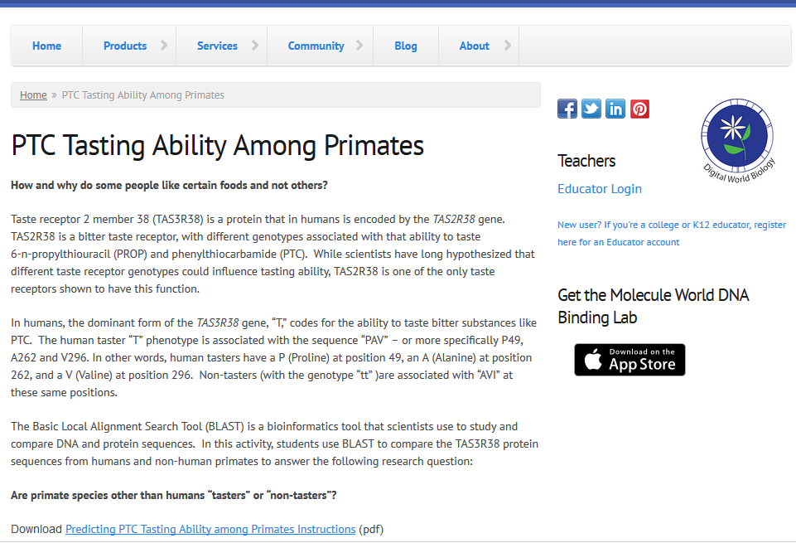
Can you taste that?
PTC Tasting Ability Among Primates
http://v3.digitalworldbiology.com/ptc-tasting-ability-among-primates

Slide 7
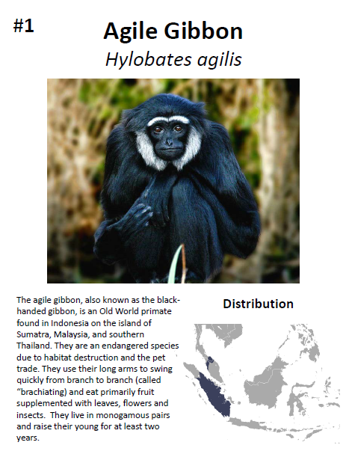
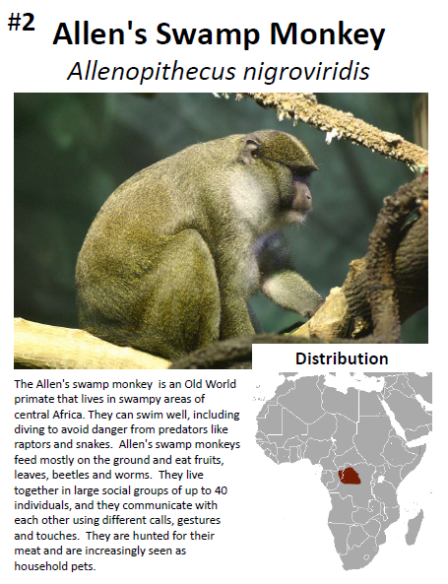
What is the predicted tasting phenotype of various non-human primates?
Factors to Consider when Making Predictions:
Diet
Geographical range
Old vs. New World primates
Monkey vs. Ape
Social Structure
Time spent rearing their young
Includes primate cards, descriptions and TAS3R38 protein sequences for 37 non-human primate species

Slide 8
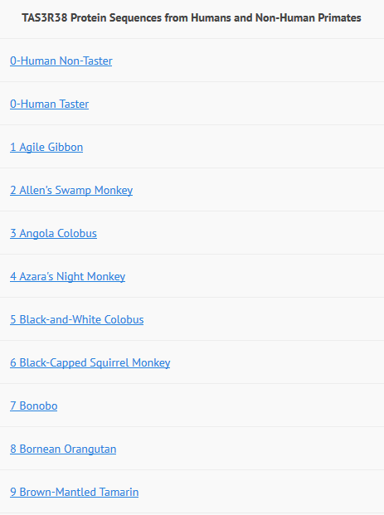
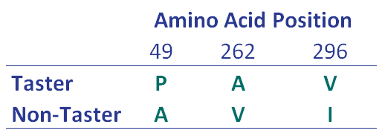
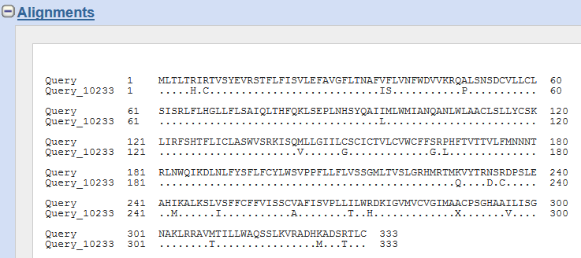
Using BLAST to Compare Human &
Non-Human Primate TAS3R38 Sequences

Slide 9
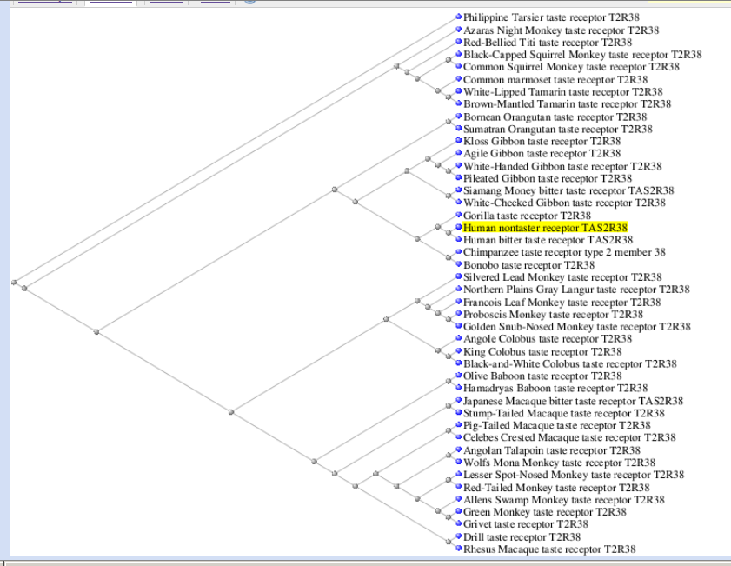
Is Tasting or Non-Tasting the More “Ancient” Trait?
Among Non-Human Primates Analyzed:
27/37 (73%) are “PAV”
10/37 (27%) are “PAI”
Among Human’s Studied*:
56% are “PAV”
38% are “AVI”
6% other (none PAI)
Sample Size = 330. Wooding et al. 2004. Am. J. Hum. Genet. 74:637-646.

