Slide 1
Bioinformatics Resources to Supplement ABE

Slide 2
What is “Bioinformatics”?
Bioinformatics is the application of computer science and information technology to biology and medicine.
National Institutes of Health Definition:
Research, development, or application of computational tools and approaches for expanding the use of biological, medical, behavioral or health data, including those to acquire, store, organize, archive, analyze or visualize such data.

Slide 3
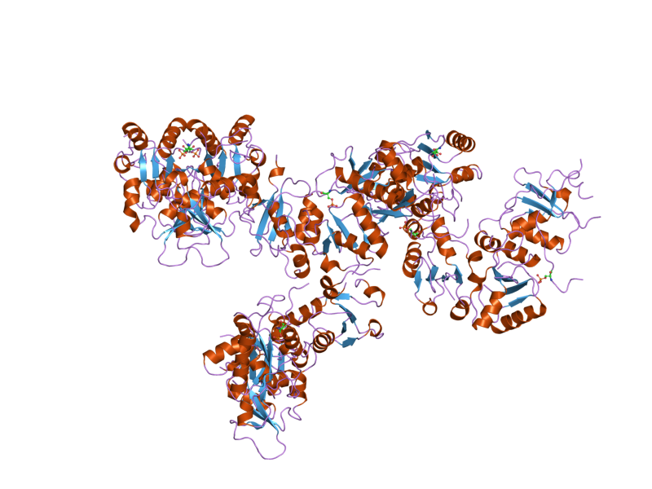
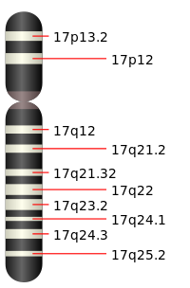
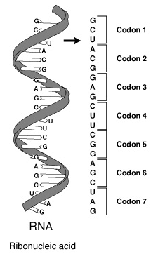
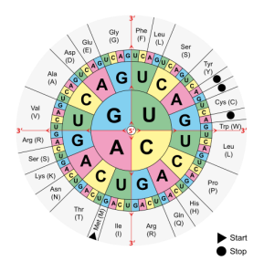
Bioinformatics Tools Help Scientists: Organize, Process, and Make Sense of Complex Biological Data Sets
DNA
RNA
Protein
Bioinformatics Tools:
DNA Sequencing
Identify Mutations in DNA.
Bioinformatics Tools:
RNA Sequencing
Identify tissue specific gene expression.
Bioinformatics Tools:
Protein 3D Structure visualization.
Identify the impact of mutations.
Image Source: Wikipedia Commons
Notes:
Bioinformatics tools help scientists organize, process and make sense of complex biological data sets

Slide 4
Bio-ITEST Curriculum Strands
Introductory
Introduction to bioethics via genetic testing
Impact of DNA mutations on protein structure
Molecular visualization, use of Databases
Model: Breast Cancer susceptibility gene 1 (BRCA1)

Slide 5
Part A: An Understanding of DNA: Making the Invisible Visible
1.5-day Workshop Offered Annually, Fall Term

Slide 6
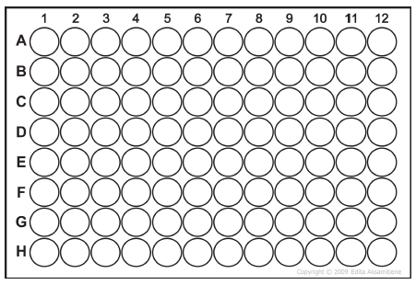
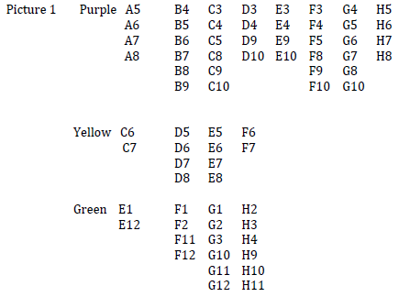
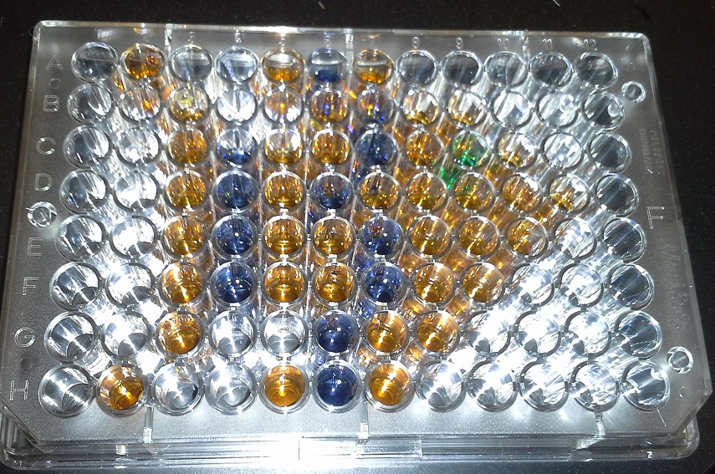
Lab 1.1: Micropipetting & Suncatchers
Micropipetting Practice with “Suncatchers”

Slide 7
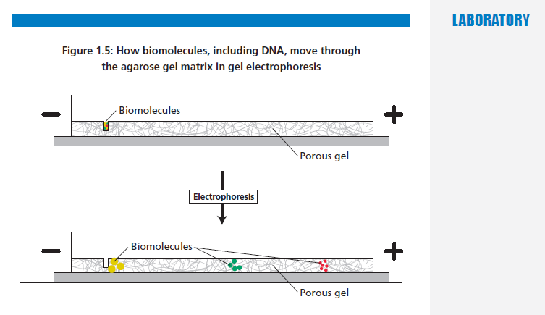
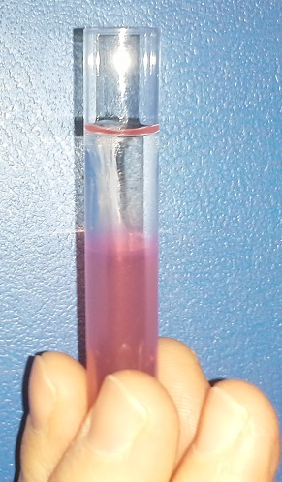
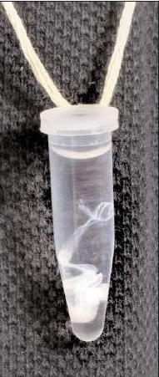
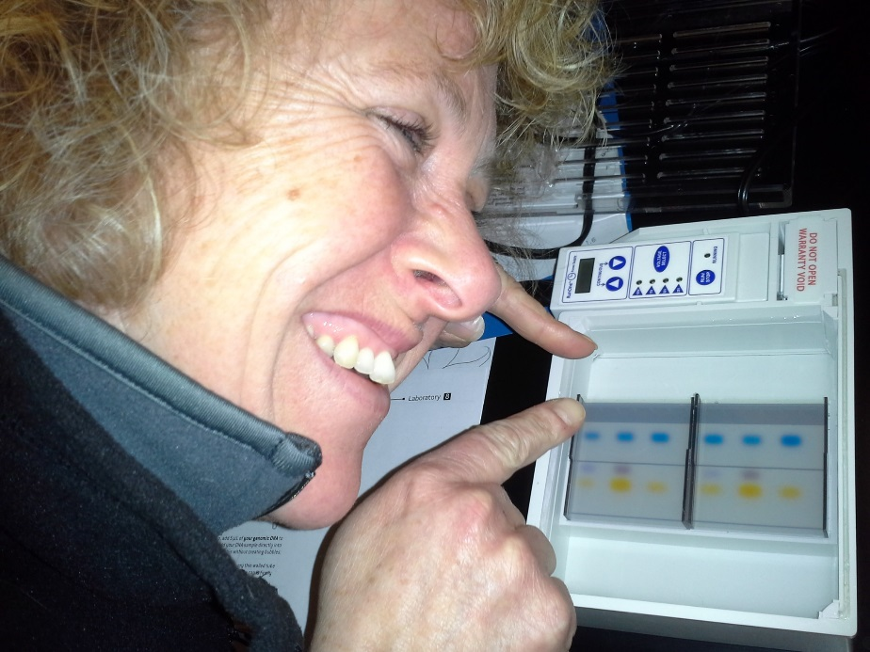
Lab 1.2: Gel Electrophoresis & DNA Extraction
Cheek Cell DNA Extraction
& DNA Necklaces
http://www.nycresistor.com/2009/11/13/diybio-at-nyc-resistor/

Slide 8
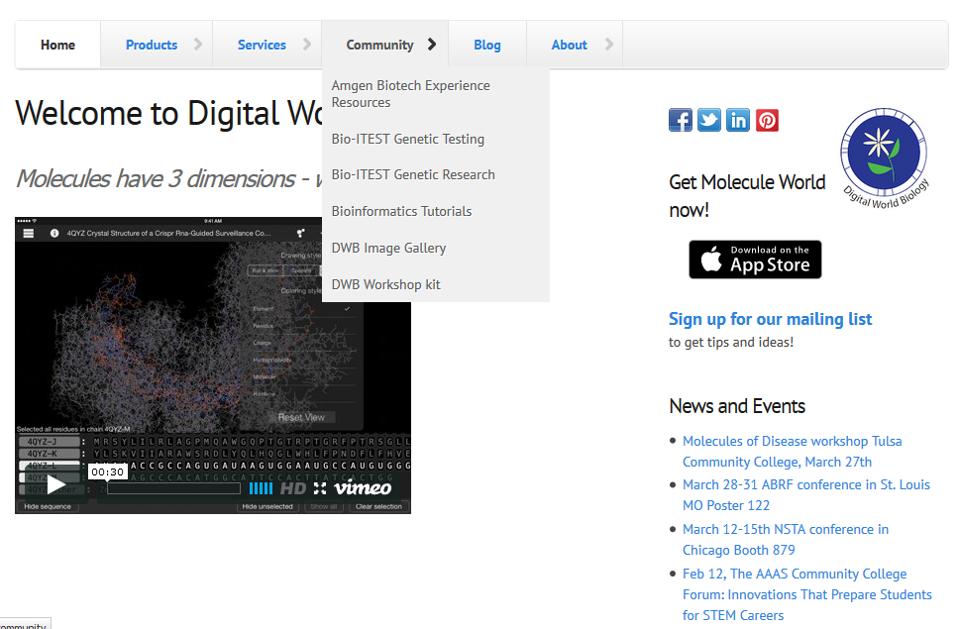
Understanding Genetic Tests to Detect BRCA1 Mutations
http://v3.digitalworldbiology.com/bio-itest-genetic-testing

Slide 9
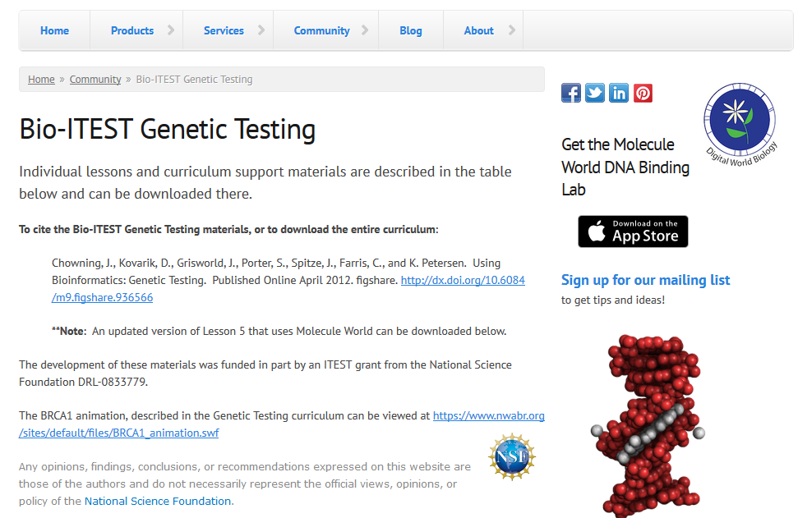
Understanding Genetic Tests to Detect BRCA1 Mutations

Slide 11
BRCA1 Genetic Testing Case Study

Slide 12
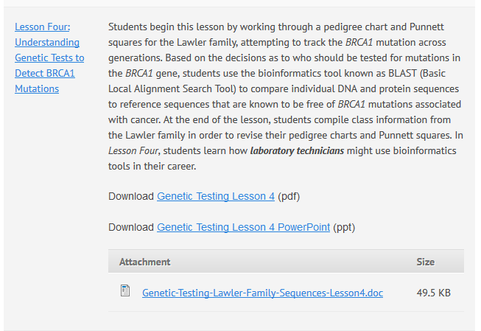
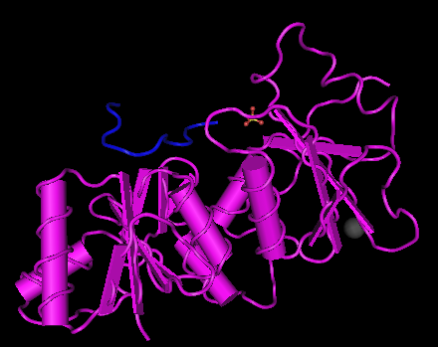
BLAST: Basic Local Alignment Search Tool
M1775R
Methionine mutated to Arginine at amino acid position 1775

Slide 13
Part C: Cloning DNA to Make Protein
1.5-day Workshop Offered Annually, Spring Term

Slide 14
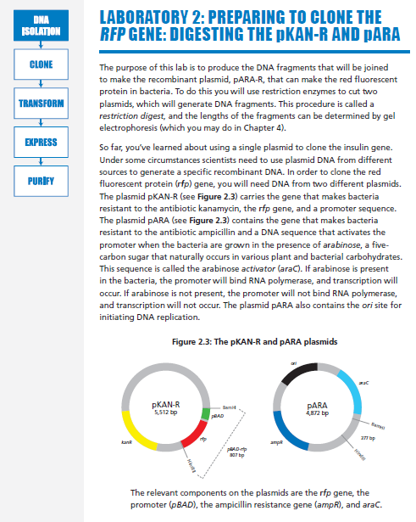
Cloning DNA….
M
A+
A-
K+
K-
L
M
A+
A-
K+
K-
L
Marty Ikkanda
Anthony Daulo
Pierce College, Woodland Hills, CA

Slide 15
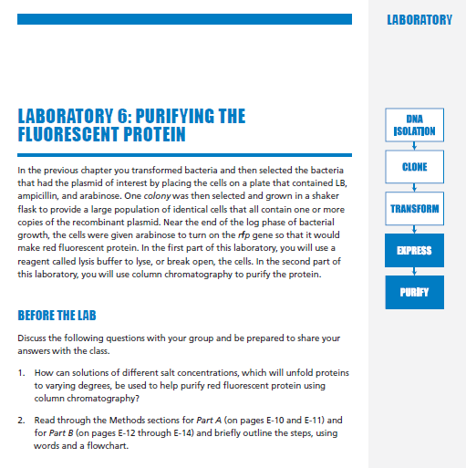
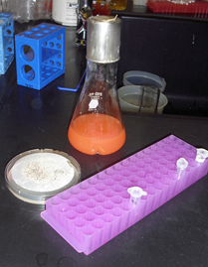
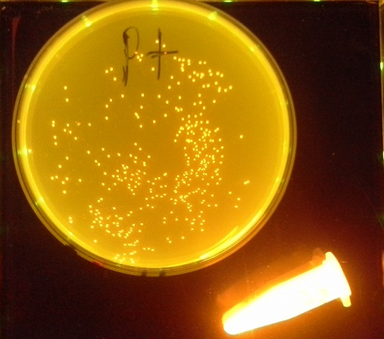
…to Make Protein

Slide 16
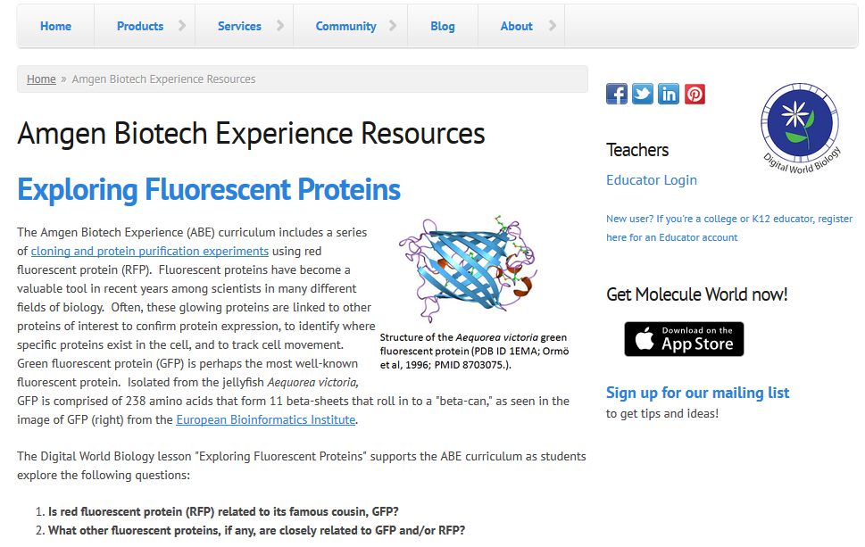
Bioinformatics & Fluorescent Proteins
http://v3.digitalworldbiology.com/abe/exploring-fluorescent-proteins

Slide 17
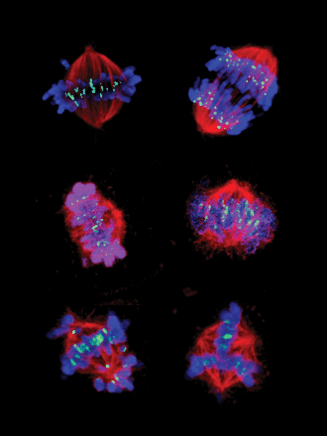
Fluorescent Proteins are Valuable Tools
Locate proteins in the cell
Track the migration of cells
Reporter of expression
Mice expressing GFP under UV light (left & right), compared to normal mouse (center).
Sister centromeres (green) mark the attachment of microtubules (red) to sister chromatids (blue). Left: Normal. Right: Drug-treated.
Source: "GFP Mice 01" Moen et al. 2012. Gene expression in tumor cells and stroma in dsRed 4T1 tumors in eGFP-expressing mice with and without enhanced oxygenation. BMC Cancer. 12:21. doi:10.1186/1471-2407-12-21 PDF. Licensed under CC BY 2.0 via Wikimedia Commons - http://commons.wikimedia.org/wiki/File:GFP_Mice_01.jpg
Source: Molecular Cancer Therapeutics. May 2003 Cover Image. http://mct.aacrjournals.org/content/2/5.cover-expansion

Slide 18
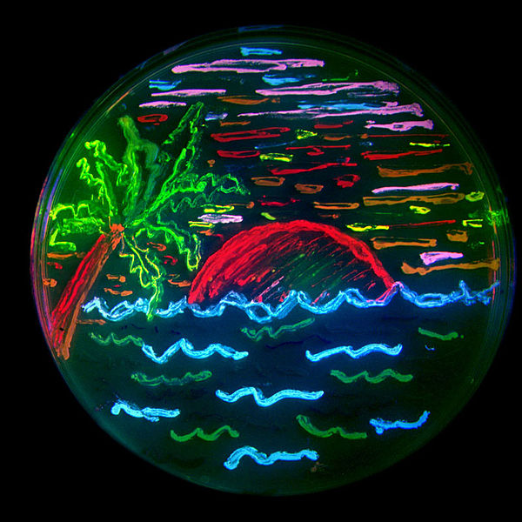
Rainbow of Fluorescent Proteins
“Drawn” with bacteria expressing 8 different fluorescent proteins
Diversity of Mutations → Diversity of Colors
“mFruits”
mBlueberry (Blue Fluorescent Protein, or BFP)
mLemon (Yellow Fluorescent Protein, or YFP)
mGrape1 (Cyan Fluorescent Protein, or CFP)
Many others, all with similarly ‘fruity’ names…
Source: "FPbeachTsien" by Nathan Shaner - transferred from en:Image:FPbeachTsien.jpg. Licensed under CC BY-SA 3.0 via Wikimedia Commons - http://commons.wikimedia.org/wiki/File:FPbeachTsien.jpg

Slide 19
Research Questions
The cloning and protein purification experiments you have been conducting in the laboratory involve mTomato, also called red fluorescent protein (RFP).
Is red fluorescent protein (RFP) related to its famous cousin, GFP?
What other fluorescent proteins, if any, are closely related to GFP and/or RFP?

Slide 20
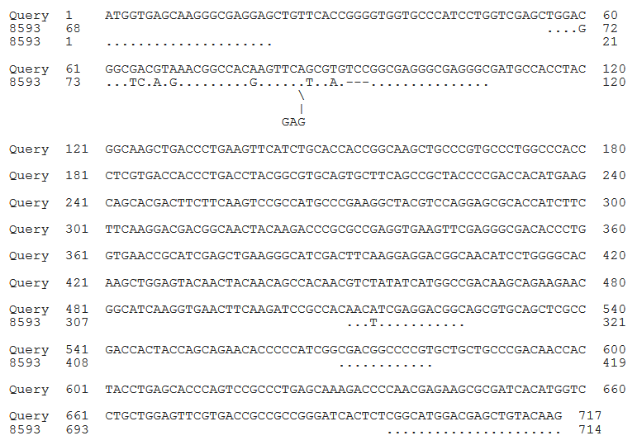
Comparing eGFP and mTomato-RFP DNA Sequences
eGFP
mTomato-RFP
Dots indicate where eGFP and mTomato-RFP align
The lack of dots indicate where eGFP and mTomato-RFP do NOT align

Slide 21
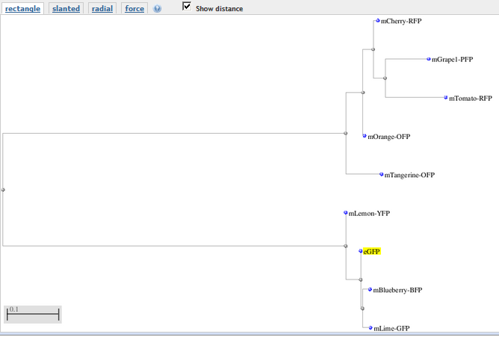
All Fluorescent Proteins: Distance Tree of Results
mTomatoRFP-related proteins
eGFP-related proteins

Slide 22
Part B: Bringing PCR into the Biology Classroom
1.5-day Workshop Offered Annually, Winter Term

Slide 23
TAS2R38 Bitter Taste Receptor [“PTC”] Gene
Left Primer
Chromosome 7
1002 bp
Right Primer
Amplify by PCR
NONTASTER (tt)
TASTER (TT)
GGCGGGCACT
GGCGGCCACT
PCR PRODUCT (221 bp)
Digest with
HaeIII Restriction Enzyme
(Recognition Sequence GGCC )
PCR PRODUCT (221 bp)
GGCGGGCACT
GGCGG
CCACT
Gel Electrophoresis
221 bp FRAGMENT
44 bp FRAGMENT
177 bp FRAGMENT
221 bp FRAGMENT
177 bp FRAGMENT
44 bp FRAGMENT
Source: Using a Single-Nucleotide Polymorphism to Predict Bitter-Tasting Ability. Dolan DNA Learning Center and Carolina Biologicals.

Slide 24
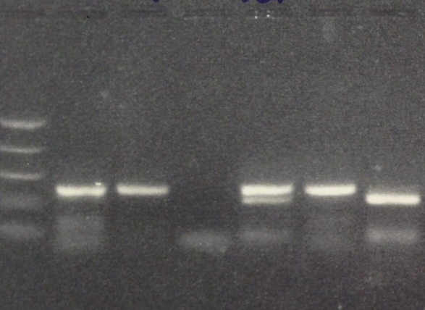
Can you taste that? PTC Tasting & Polymerase Chain Reaction (PCR)
U = Undigested PCR Product
D = Digested PCR Product
Day 1: Isolating DNA
Day 2: Performing PCR
Day 3: Restriction Digest of PCR Product
Day 4: Agarose Gel Electrophoresis & PTC Tasting Paper
Day 5: Bioinformatics Activity
MW TT Tt tt
U D U D U D
TT = 221 bp FRAGMENT
Tt = 221 bp, 177 bp & 44 bp* FRAGMENTS
tt = 177 bp & 44 bp* FRAGMENTS
*44 bp FRAGMENT difficult to visualize

Slide 25
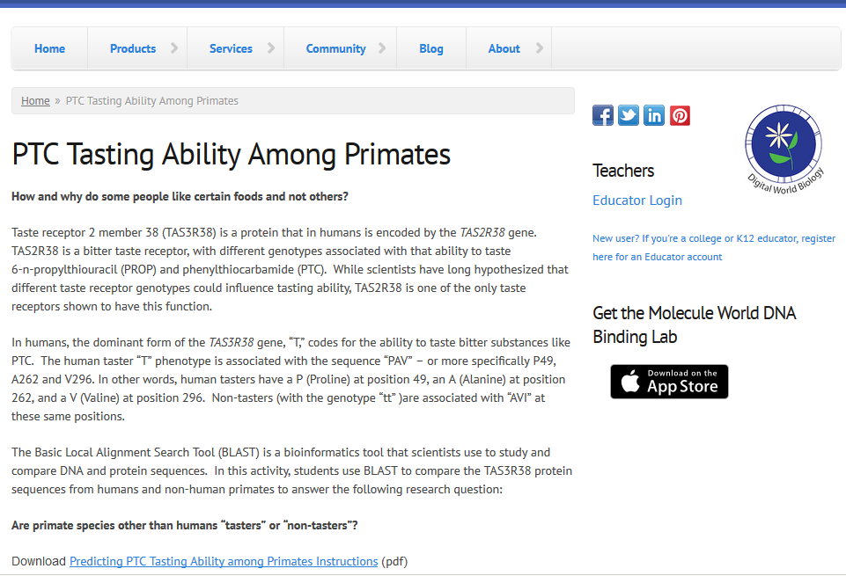
Can you taste that? PTC Tasting Ability Among Primates
http://v3.digitalworldbiology.com/ptc-tasting-ability-among-primates

Slide 26
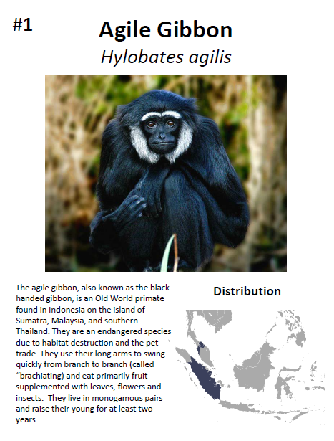
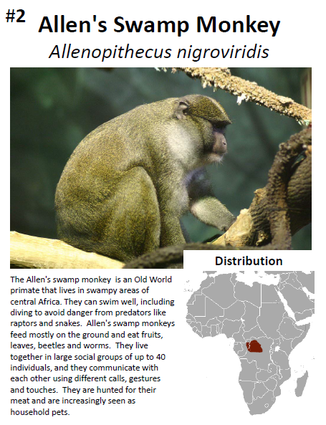
What is the predicted tasting phenotype of various non-human primates?
Factors to Consider when Making Predictions:
Diet
Geographical range
Old vs. New World primates
Monkey vs. Ape
Social Structure
Time spent rearing their young
Includes primate cards, descriptions and TAS3R38 protein sequences for 37 non-human primate species

Slide 27
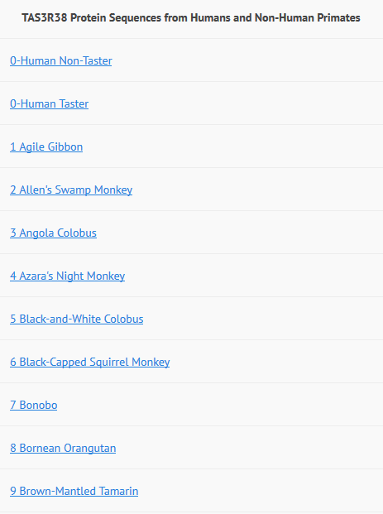
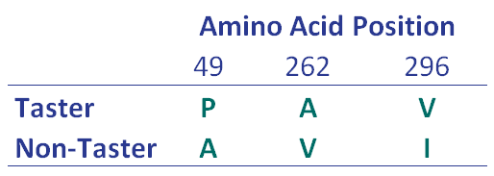
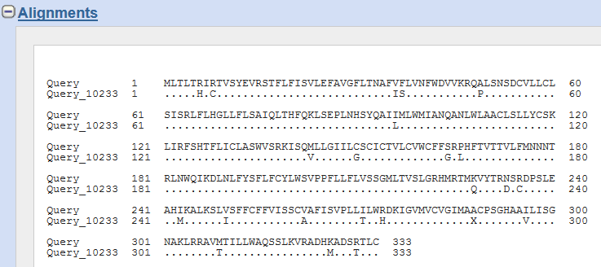
Using BLAST to Compare Human & Non-Human Primate TAS3R38 Sequences

Slide 28
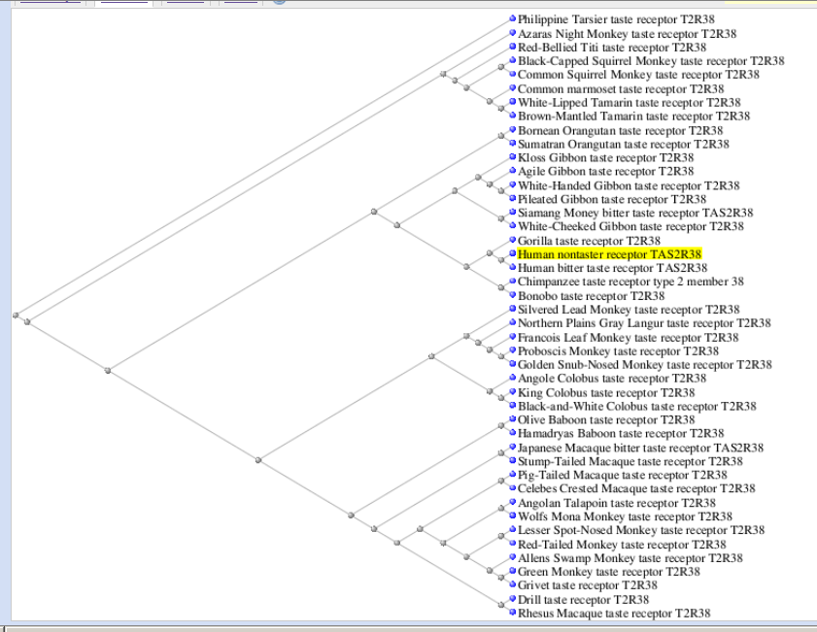
Is Tasting or Non-Tasting the More “Ancient” Trait?
Among Non-Human Primates Analyzed:
27/37 (73%) are “PAV”
10/37 (27%) are “PAI”
Among Human’s Studied*:
56% are “PAV”
38% are “AVI”
6% other (none PAI)
Sample Size = 330. Wooding et al. 2004. Am. J. Hum. Genet. 74:637-646.

