Slide 1


ABE Labs 1.1 and 1.2
Tools of the Trade

Slide 2

CHAPTER 1:
Some Tools of the Trade
Lab 1.1
2014

Slide 3

Purpose of Lab 1.1
Become familiar with the small volumes of solutions used in molecular biology
Introduce proper use of the micropipette
Practice using the micropipette
http://kcts9.pbslearningmedia.org/resource/biot11.sci.life.gen.usingmicro/using-a-micropipette/

Slide 4
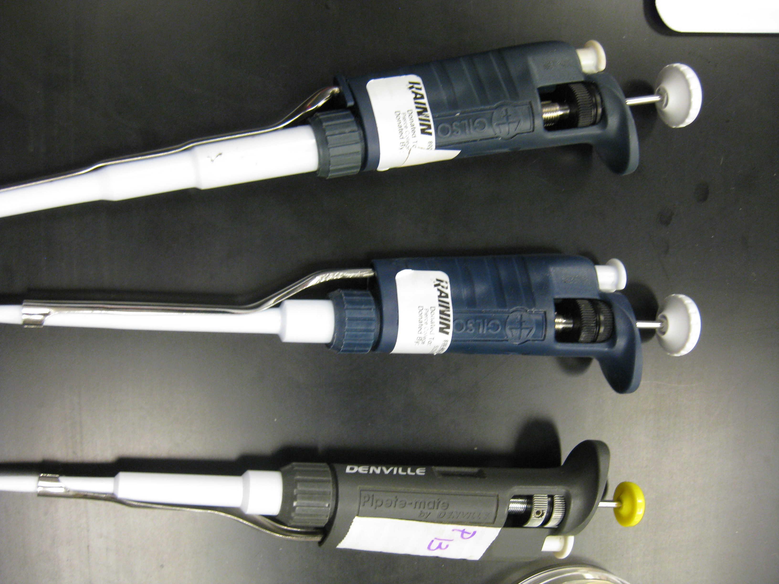
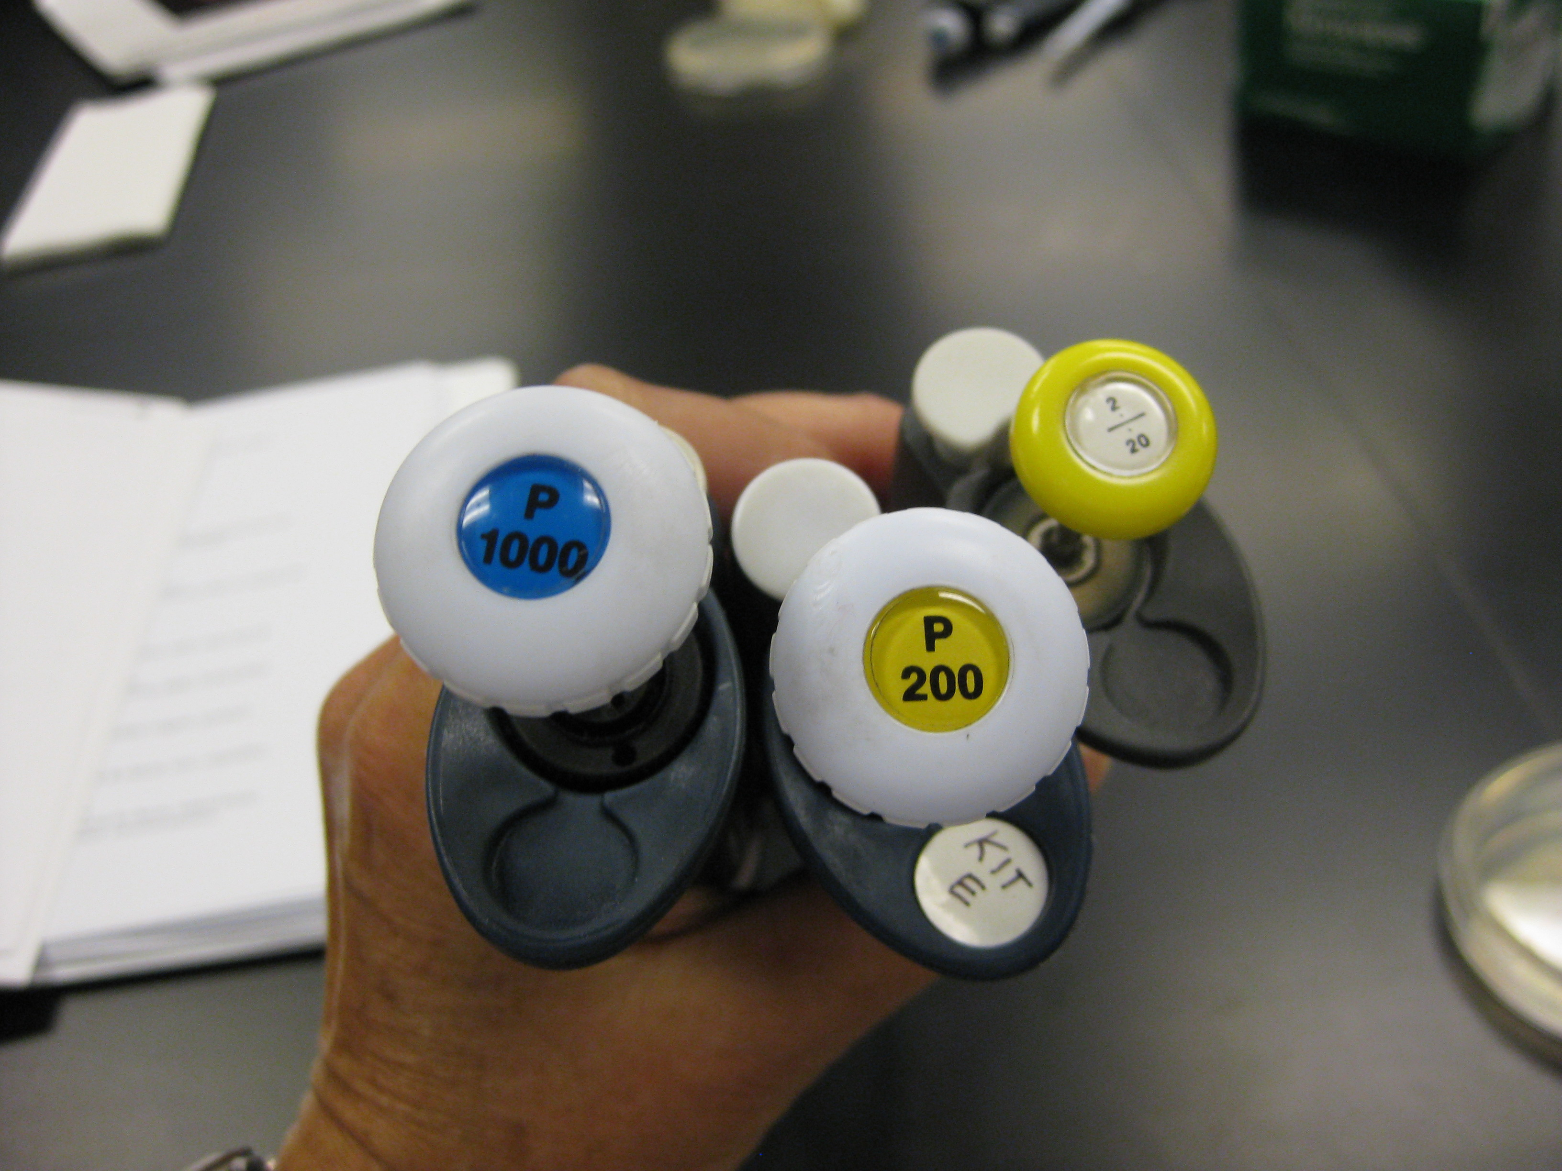
Micropipettes

Slide 5
Parts of the Micropipette

Slide 6
Micropipette Use
Twist dial to desired volume
Add disposable pipette tip
Press plunger to first stop
To retrieve liquid, slowly release plunger
To transfer liquid, press plunger past first stop to second stop
Keep plunger down as you remove pipette
Eject tip

Slide 7
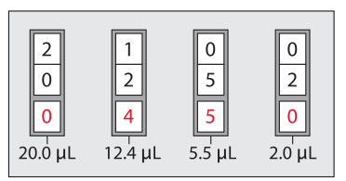
Reading a P-20 Micropipette

Slide 8
Reading a Micropipette (cont.)
P-20
P-200
P-2000
0
0
0
5
5
5
0
0
0
5 μL
50 μL
500 μL

Slide 9
Micropipetting “Nevers”
Never use a micropipette without a tip
Never lay a micropipette down with sample in the tip
Never let the plunger button snap back
Never set the micropipette outside its range (for example, a P20 pipette below 2.0μL or above 20.0μL)

Slide 10
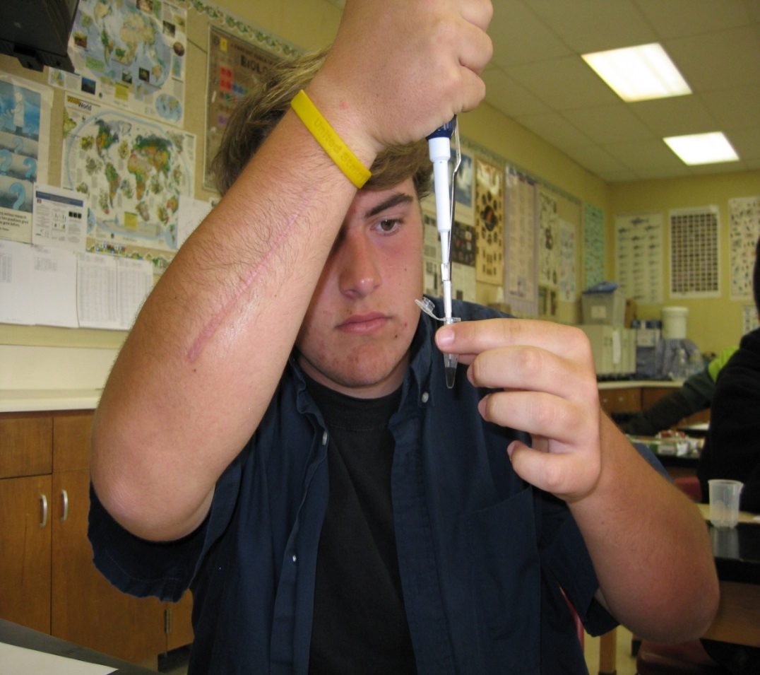
Pipetting Techniques
Hold micropipette and microfuge tubes at eye level when loading or dispensing samples

Slide 11
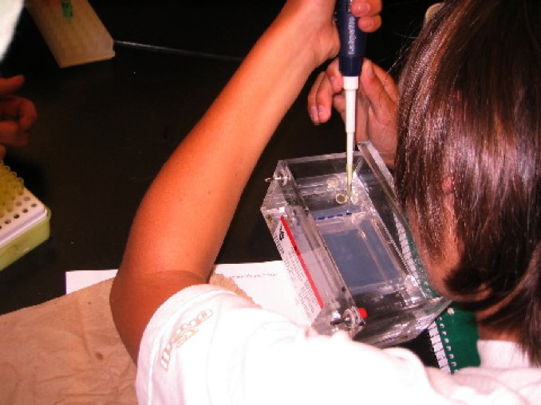
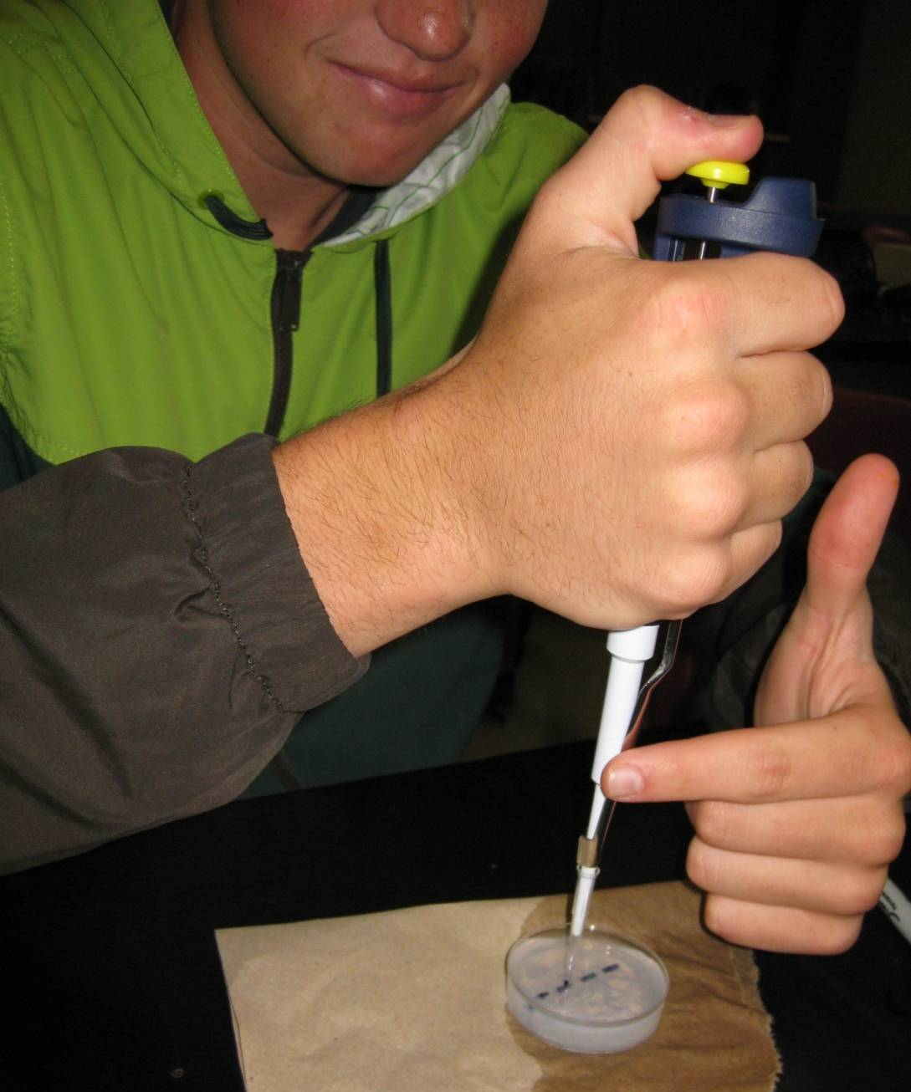
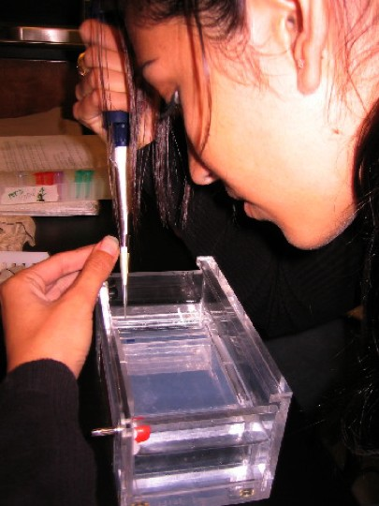
Pipetting Techniques (cont.)
Place both elbows on the table and use your other hand to stabilize the bottom of the pipette

Slide 12
Practice Pipetting Sheet
20 μL
0
0
0
0
15 μL
0
0
0
0
10 μL
0
0
0
0
5 μL
0
0
0
0
2 μL
0
0
0
0

Slide 13
CHAPTER 1:
Some Tools of the Trade
Lab 1.2
2014

Slide 14
Purpose of Lab 1.2
Become familiar with gel electrophoresis
Practice using the micropipette to load wells in practice plates
Practice running an electrophoresis gel using three dyes: xylene cyanole, bromophenol blue, and orange G

Slide 15
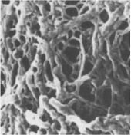
Magnified Agarose Matrix

Slide 16
Loading Gels
Insert pipette tip:
Under buffer level
Above gel well
Running an Agarose Gel:
http://kcts9.pbslearningmedia.org/resource/biot11.sci.life.gen.agaroserun/running-an-agarose-gel/

Slide 17
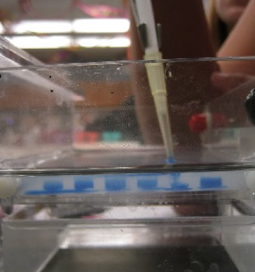
Improper Loading Technique
Tip is in the well
Tip punched through the gel
Dye spreading under the well

Slide 18
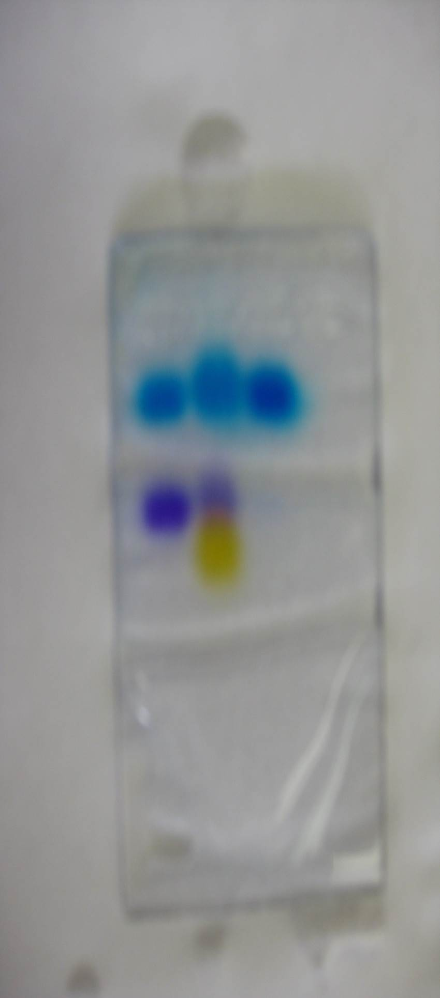
Analysis of Sample Composition
Sample A has blue and purple dye
Sample B has blue, purple, and yellow dye
Sample C has blue dye
A
B
C

Slide 19
Predicted Dye Molecular Weights
Heaviest is blue dye (xylene cyanole)
Middle is purple dye (bromophenol blue)
Lightest is yellow dye (orange G)
A
B
C

Slide 20
Actual Dye Molecular Weights
Heaviest is purple dye (bromophenol blue) – 670.0 amu
Middle is blue dye (xylene cyanole) – 538.6 amu
Lightest is yellow dye (orange G) – 452.4 amu

Slide 21
Dye Molecular Weight Discrepency
Purple dye (bromophenol blue) has more negative charge per unit of mass than blue dye (xylene cyanole) due to presense of bromine ions
The heavier purple dye molecule travels farther through the gel than the lighter blue dye molecule

