Slide 1


New Employee Orientation

Slide 2

Agenda
Introductions
Shoreline College – Who we are and what do we stand for
General Timekeeping, Payroll, Holidays, etc.
Required Trainings & Professional Development
Emergency Information
Campus Tour
Benefits Coordinator Presentation

Slide 3
Introductions
Name
Position
Work snack/drink
Favorite productivity tool/strategy
What are you excited about for your new position

Slide 4
Land Acknowledgment
Shoreline College acknowledges that we occupy the ancestral lands of the Coast Salish Peoples. We recognize The Coast Salish people as the caretakers of this land since time immemorial and as a community, we strive towards building authentic relationships with the sovereign nations of this region. In addition, Shoreline College is committed to truth and reconciliation, and the fostering of an inclusive and supportive environment for all Indigenous communities.

Slide 5
Mission
Shoreline College offers accessible, high-quality education and workforce training that empowers students for success.
Rooted in our commitment to diversity, equity, and community engagement, we foster an educational environment that contributes to the enrichment of both our local and global communities.

Slide 6
Vision
We envision a future:
  Where every student has equitable access to an affordable, transformative education
  Where lived experiences do not predict success and
  Where the diversity of student experiences enriches us all.

Slide 7
Values
Diversity and Inclusion: Creating an inclusive environment for students and staff that values every individual’s unique perspective and contribution.
Student-Centered: Placing students at the heart of our actions, prioritizing their needs, aspirations, and well-being in all aspects of the college experience.
Community Engagement: Fostering collaboration within our wider community to collectively address needs and enhance the overall well-being of our region.
Quality Education: Providing an equitable learning environment and a commitment to teaching excellence that ensures that our students acquire the knowledge and skills needed for success in their careers and as global citizens.
Accessibility and Affordability: Removing obstacles and providing essential resources to support students along their educational journey.

Slide 8


Slide 9
Shoreline's Community Standard
"Injustice anywhere is a threat to justice everywhere. We are caught in an inescapable network of mutuality, tied in a single garment of destiny. Whatever affects one directly, affects all indirectly...“ ~ Rev. Dr. Martin Luther King, Jr.
Shoreline College is a place for students, employees, and the community to pursue excellence in education in an environment dedicated to equity, inclusiveness, and self-reflection. We value respectful, dynamic interactions and lively discussion. We strive to create an environment where everyone is supported and valued. Shoreline College does not tolerate hateful, violent, or discriminatory actions that target any person or group based on their beliefs, customs, identity, or affiliations. When one of us is diminished, all of us are diminished.
How is it relevant to your position?

Slide 10








Your Executive Team (aka “ET”)
Jack Kahn
College President
Brian Crisanto Ramos
VP for DEIA
Ann Garnsey-Harter
Assoc VP – Planning & Institutional Effectiveness
Ryan Aiello VP for Student Affairs & Academic Affairs
Samira Pardanani
Assoc VP for Student Services & Int'l Education
Joe Mazur
VP for Business and Admin Services
Exec Director of Human Resources
April Nilsen
Assoc VP – Development & Community Engagement / Exec Director - Foundation
Cat Chiappa Exec Director of Strategic Communication & Marketing

Slide 11
Working at SCC
Classified Permanent
(Full/Part Time)
6 mo probation
Admin/Exempt
Supervisors, Deans, VP’s etc.
Faculty
Full time – Annual Contracts
Ongoing (no annual contracts)
WFSE Union
Overtime eligible
Ongoing
No union
Not overtime eligible
Associate/Adjunct/PTF – Quarterly contracts
Temp, Tenure-Track, Tenured

Slide 12
Working at SCC
Student & Work-Study
Temporary
Temp Hrly & Classified NPE
Temporary
Volunteers/POI
Vol – event support, unpaid interns, welcomers, English practice groups
Int’l Students
Overtime Eligible
Employment ends either when HR is informed or at end of academic year
Person of Interest – Contractors, vendors, associated with but not paid by Shoreline

Slide 13
Reporting Time & Payroll Periods

Slide 14
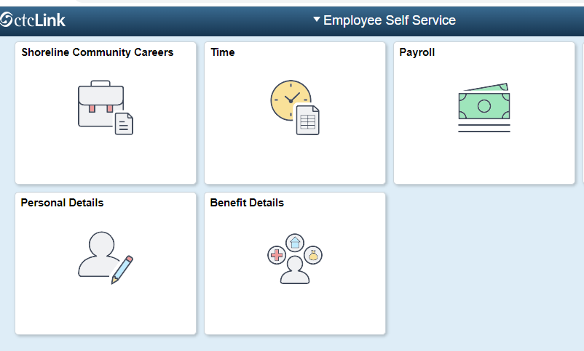
Reporting Time & Leave
Classified, Temporary, Hourly, Volunteers & Students – submit hours worked per day for each pay period
Admin/Exempt & Faculty – only report leave
Breaks and Lunch do NOT need to be reported in CTC Link (except for hourly employees) but are to be taken
Directions on website Knowledge Base

Slide 15

Pay Periods
Pay period A: 1st - 15th of the month
    Timesheets due on the 15th
    (or the last working day of the pay period)
  Paid on the 25th
Pay period B: 16th - end of the month
  Time sheets due last working day of the month
  Paid on the 10th

Slide 16

Classified – Full-time
    8 hours of sick leave/mo
  Vacation starts at 11hrs 20min/month for 1st -6th yr of employment
  1 Personal Holiday/calendar year, after 4 mo (use or lose by Dec 31st)
  3 Personal Leave days/fiscal year, after 4 mo (use or lose annually 7/1-6/30)
Admin/Exempt – Full-time
    8 hours of sick leave/mo
  16 hours of vacation/mo
  1 Personal Holiday/calendar year, after 4 months (use or lose by Dec 31st)
Full-Time Faculty
  12 days of personal leave granted at first day of academic year contract during 1 year of employment.
  2nd year forward, accumulates 4 days per quarter at start of each quarter worked.
Leave Details

Slide 17
Holidays
New Year’s Day - January 1st
Martin Luther King Jr. Day - 3rd Monday in Jan
President’s Day - 3rd Monday in Feb
Memorial Day - Last Monday in May
Juneteenth - June 19th
Independence Day - July 4th
Labor Day - 1st Monday in Sept
Veterans Day - November 11th
Thanksgiving Day - 4th Thursday in Nov
Native American Heritage Day - Fri after Thanksgiving
Christmas Day - December 25th
*Generally, the College will also be closed for 4 additional days around Christmas

Slide 18

Campus Benefits
Conference Rooms & Computer Labs
Aveta Food to Go – Pagoda Union Building 9000 (PUB)
Library Access - Ray W. Howard Library & Technology Center
Parent Child Center (PCC) – on-site daycare with special employee rates
Fitness Center and Gym – Hours on website
Free Rideshare Shuttle
Access to College Community events and workshops
Mailing Services - PUB
Food Trucks
2 Annual Employee/Faculty training events

Slide 19

Parking – Permits Required
Bring your Employee ID number, license plate number, and photo ID to the
Safety & Security Office
(bottom floor of 5000 Foss Building)
Classified & Faculty – Union bargained free passes
Administrative - $30/mo for those working 50%+ for more than 6mo

Slide 20
Title IX
Title IX is a federal law that prohibits all forms of gender discrimination (including sexual harassment, sexual violence and domestic violence) in educational organizations that receive federal funding. Title IX applies to both students and employees. All employees have two important responsibilities related to Title IX:
Complete annual Title IX training.
Report instances of gender discrimination or suspected gender discrimination involving students or other employees to the Title IX/EEO Coordinator- Liam O’Connor (titleIXcoordinator@shoreline.edu)
For more information on Title IX visit https://www.shoreline.edu/title-ix/

Slide 21

Required Annual Trainings
Family Educational Rights and Privacy Act (FERPA)
Cybersecurity Awareness for Employees of Educational Institutions
Building Supportive Communities: Clery Act & Title IX
Hazing Awareness and Prevention
Look for an activation email from Vector - use your Shoreline credentials

Slide 22

Education & Training
Classified Professional Development Committee
Exempt Training Funds
Tuition Waiver
Faculty Professional Development
Linked In Learning
(Use Shoreline email)
Canvas

Slide 23
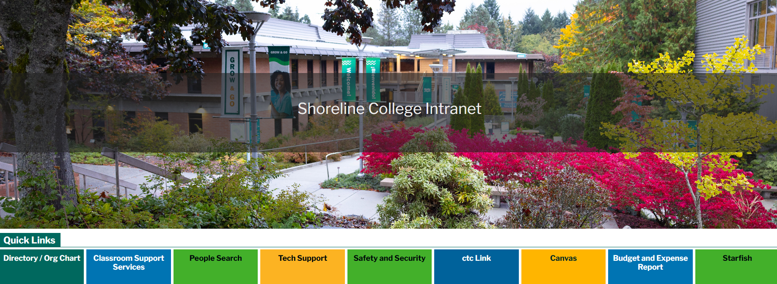
shorelineccwa.sharepoint.com/sites/Intranet

Slide 24
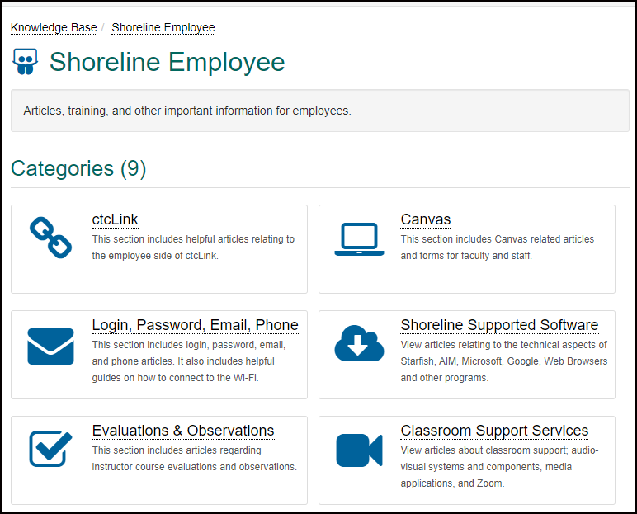
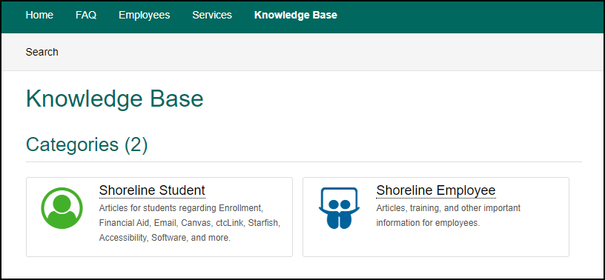
Knowledge Base
Shoreline.edu -> Student Support -> Support Center

Slide 25
Emergency
A Campus Safety officer is on duty 24 hours a day, 7 days a week
  Call (206) 235-5860 PLEASE PUT THIS INTO YOUR PHONE NOW
  Non-Emergency campus.safety@shoreline.edu
  Review important information in the Campus Safety section of the Shoreline website
Emergency Alert - RAVE
  https://www.getrave.com/login/shoreline
  Log in and update settings

Slide 26
Getting Started
Your Supervisor
    Computers & Access
    Business cards
    Name Tag
    Parking Pass
    Office/Building Keys
Comm. & Marketing (Identity Guidelines)
    Logos
    Color palette
    Email signature template
    Power point templates
Technology Support Services (TSS)
    Put in a ticket in the Services Request on our website

Slide 27
Questions?

Slide 28
Thank you!
Next: Campus Tour & Benefits Presentation

Slide 29

Welcome to Shoreline College
Public Employee Benefits Board (PEBB) Plan and other offered employee benefits

Slide 30

What are Public Employees Benefits?
Health
  Medical
  Dental
  Vision
Life and AD&D Insurance
Long-Term Disability Insurance
Optional Benefits available to PEBB members
  Dependent Care Assistance (DCAP)
  Flexible Spending Account (FSA)
  Supplemental Life and AD&D
  Supplemental LTD
  Home and Auto Insurance

Slide 31

Benefits Effective Date
Coverage effective date is based on your first day of employment
  Coverage begins the 1st day of the month following the date the employee became eligible (first day of work is June 6th, then coverage begins July 1st)
  OR Coverage begins the first working day of the month (first day of work is May 1st, then benefits will be effective May 1st)
  A-1 Worksheet has coverage begin date and deadlines to submit forms

Slide 32

Deadline to submit forms
  Benefits Office must receive all benefit enrollment forms and supporting documents no later than 31 days after the first day of employment
  Default enrollments if forms are not submitted by the 31-day deadline:
    Uniform Medical Plan Classic, Uniform Dental Plan and MetLife Vision
    Basic Life insurance, Basic Accidental Death, and Dismemberment (AD&D) insurance
    Employer-paid Long-term Disability (LTD) insurance AND employee-paid (LTD) insurance
    Dependents will not be enrolled
    A monthly tobacco use premium surcharge will be incurred (WAC 182-08-197 (1)(b))

Slide 33

Eligible dependents
Spouse
State Registered Domestic Partner
Children under the age of 26 except for children with disability
Dependent Verification Documents
Examples on page 9 of the PEBB Employee Enrollment Guide

Slide 34
Waiving Coverage
Employees can waive medical plan ONLY, if enrolled in one of the following other plans:
  another employer-based group medical plan
  TRICARE
  Medicare (Parts A and B only)

Slide 35
Spousal/State-Registered Domestic Partner (SRDP) Surcharge
Enrolling a spouse or SRDP in PEBB benefits could result in an additional $50/month surcharge
  If spouse/SRDP has chosen not to enroll in another employer-based group medical that is comparable to Uniform Medical Plan (UMP) Classic.
Find out if the surcharge applies to you:
  Fill out the 2026 PEBB Premium Surcharge Attestation Change Form
  Use the 2026 Spousal plan calculator form
    if you answer 'YES' to all the questions on your enrollment form and are wanting to enroll a spouse or state-registered domestic partner.

Slide 36
2026
Annual Open Enrollment
October 26th – November 23rd
Making changes during open enrollment
  Change medical, vision, and/or dental plans
  Waive medical coverage
  Add or remove eligible dependents
  Sign-up for FSA and/or DCAP
  Re-attest to the spouse/SRDP premium surcharge, if applicable
All changes must be received by the benefits office or submitted online as follows:
  No earlier than October 26, 2026
  No later than November 23, 2026
Changes take effect January 1st of the following year

Slide 37
“Special” Open Enrollment
When making changes to health benefits due to a qualifying event
  A life event that causes loss of health insurance
  Examples on page 50-51 of benefits guide
Submit your changes and your proof of event in Benefits 24/7 or submit required forms and supporting documents to your benefits office no later than 60 days after the event.

Slide 38

Medical plans
Uniform and Kaiser Based Plans
  Uniform Medical Plan (UMP) plans - administered by Regence BlueShield (PPO) and ArrayRx
  Kaiser Permanente (HMO)
  Kaiser Permanente NW
    offered in Clark and Cowlitz counties only
See the 2026 PEBB Employee Enrollment Guide for more information about each plan
  Monthly premiums (page 22)
  Out of pocket medical expenses (pages 34-46)
  In-network vs out-of-network (Pages 26-28)
Please contact the plan(s) for specific questions

Slide 39

Dental Plans
No dental premiums for employee or dependents
Compare out-of-pocket expenses
  2026 PEBB Employee Enrollment Guide (Page 42)
DeltaCare and Uniform Dental Plan are both managed through Delta Dental
DeltaCare and Willamette Dental Group are managed-care plans.
  You must choose a primary dental provider within their networks.
    If you do not choose a primary dental provider, one will be chosen for you.
  These plans will not pay claims if you see a provider outside of their network.
Three Plans to Choose From
  Willamette Dental Plan (managed-care plan)
  DeltaCare (managed-care plan)
  Uniform Dental Plan (PPO plan)

Slide 40
Vision Plans
No vision premiums for employee or dependent(s)
Three plans to choose from:
  Davis Vision by MetLife
  EyeMed
  MetLife Vision (Default)
Compare out-of-pocket expenses
  2026 PEBB Employee Enrollment Guide (Page 44-46)

Slide 41

Life and Accidental Death & Dismemberment Insurance
Free basic $35,000 life insurance
Free basic AD&D $5000
Supplemental life insurance premiums on page 57
  Sign up within 31 days without underwriting
  Enroll online through the MetLife website
  Designate beneficiaries

Slide 42
Long-Term Disability Insurance
Free basic (“employer-paid”) LTD maximum monthly benefit $450
Employee-paid (“supplemental”) LTD
  60% benefit with 90 day waiting period (automatic enrollment)
    Max benefit $10,000/month
  50% benefit with 90 day waiting period (you can decrease at any time)
    Max benefit $8,333/month
  Decline benefit (you can decline at any time)
Premium Calculator: https://www.standard.com/mybenefits/wapebb/premium-ltd.html
Deductions based on your retirement plan, monthly pre-disability earnings, and desired coverage level (50% or 60%)

Slide 43
Flexible Spending Arrangement (FSA)
Flexible Spending Arrangements (FSAs) allow you to set aside pretax money from your paycheck to pay for out-of-pocket health care costs (co-pays, medications, dental care, vision services).
  Navia Benefit Solutions processes claims
You must enroll in an FSA each year you want to participate
  Enrollment does not automatically continue from year-to-year
Enrollment Deadline is 31 days from benefit eligibility date
2026 Annual FSA Contributions:
  Minimum of $120
  Maximum of $3,400
Represented employees may receive a $300 FSA benefit through your collective bargaining agreement. Your rate of pay on November 1st of previous year must be $68,004 or less for a full-time equivalent position.

Slide 44
Dependent Care Assistance Program (DCAP)
The DCAP allows you to set aside pretax money from your paycheck to help pay for qualifying childcare or elder care expenses.
  The Health Care Authority (HCA) contracts with Navia Benefit Solutions to process claims and provide customer service for PEBB members.
Submit your enrollment form no later than 31 days after the date you become eligible for PEBB benefits.
  More information on pages 63-64
The minimum DCAP contribution is $120
The maximum DCAP contributions are limited to:
  $7,500 annually for a single person or married couple filing a joint income tax return.
  $3,750 annually for each married participant who files a separate income tax return.

Slide 45

Smart Health Challenge!
Each year, subscribers can qualify for a $125 wellness incentive.
  Complete all three steps within the deadline to qualify each year. (Nov 30th)
    Sign in to SmartHealth at smarthealth.hca.wa.gov or on the Wellness At Your Side app. For help logging in, visit hca.wa.gov/accessing-smarthealth.
    Complete the SmartHealth well-being assessment. It takes about 15 minutes and is worth 800 points.
    Join and track activities to earn at least 2,000 total points before your deadline.
How you receive the incentive depends on the type of medical plan you enroll in.
  For consumer-directed health plans (CDHPs):
    A one-time deposit of $125 goes into the subscriber’s health savings account (HSA) the following year.
  For all other PEBB medical plans:
    Subscribers get a $125 reduction in their PEBB medical plan deductible the following year.
Details on page 65

Slide 46
Retirement Plans
State Board Retirement Plan
*Administered by TIAA
Public Employees’ Retirement System
*Administered by DRS
SBRP
Faculty and Exempt Employees
Employee Contribution Rates
  Under Age 35 ----- 5%
  Age 35 - 49 ----- 7.5%
  Age 50+ ----- 10%
College matches 100%
Vesting: Immediately
Default Plan for Faculty and Exempt employees
PERS 3
Exempt and Classified Employees
Employee Contribution Rates
  5% all ages
  5% up to 35, 6% 35 - 44, 7.5% 45+
  6% up to 35, 7.5% 35 - 44, 8.5% 45+
  7% all ages
  10% all ages
  15% all ages
Employer Contribution Rate
  5.58% (as of 7/1/25)
Vesting: 10 years
Investment choices
  Self-Directed
  Washington State Investment Board (WSIB)
PERS 2
Classified Employees
Employee Contribution Rate
  5.38% (as of 7/1/25)
Employer Contribution Rate
  5.58% (as of 7/1/25)
Vesting: 5 years
Default Plan for Classified employees

Slide 47
Faculty Retirement Plans
**No prior DRS history
TRS 3 (Teachers’ Retirement System)
*Administered by DRS
Employee Contribution Rates:
  5% all ages
  5% up to 35, 6% 35 - 44, 7.5% 45+
  6% up to 35, 7.5% 35 - 44, 8.5% 45+
  7% all ages
  10% all ages
  15% all ages
Employer Contribution Rate
  7.74% (effective 9/1/25)
Investment choices
  Self-Directed
  Washington State Investment Board (WSIB)
Vesting (must qualify with ONE of the following):
  10 years of service
  5 years of service with at least 12 months earned after age 44
  5 years of service earned in TRS Plan 2 prior to June 1, 2003
HERP (Higher Education Retirement Plan)
*SBRP Administered by TIAA
Employee Contribution Rates:
  Under Age 35 ----- 5%
  Age 35 - 49 ----- 7.5%
  Age 50+ ----- 10%
College matches 100%
Vesting: Immediately
Default Plan for Faculty

Slide 48

Deferred Compensation Plan (Auto-Enroll)
The DCP 457 is a supplemental retirement savings program that you control
  Pre-tax or after-tax options
  Administered by Department of Retirement System (DRS)
Default to Automatic Enrollment
  3% of gross income
    Deduction begins about 2 months after your hire date
    Within 90 days of your first contribution, you can still withdraw your automatic enrollment contributions and stop your deferrals and withdraw these contributions
  90 days after your first contribution, at any time during your employment, you can change or stop your contributions, and you can change investment options
  Opt-out of within 60 days of hire by emailing or calling DRS
    Email: www.drs.wa.gov/login
    Phone: 888-327-5596
If you opt-out of DCP you will have opportunity to sign up later
Maximum amount you can contribute to your DCP
  $24,500 — If you are under age 50
  Additional $8,000 — For age 50+; Catch-up Contributions
  Special Catch-up limit of $49,000 could be available, to those participants within 3 years of retirement. To determine your eligibility, call DRS at 800-547-6657

Slide 49
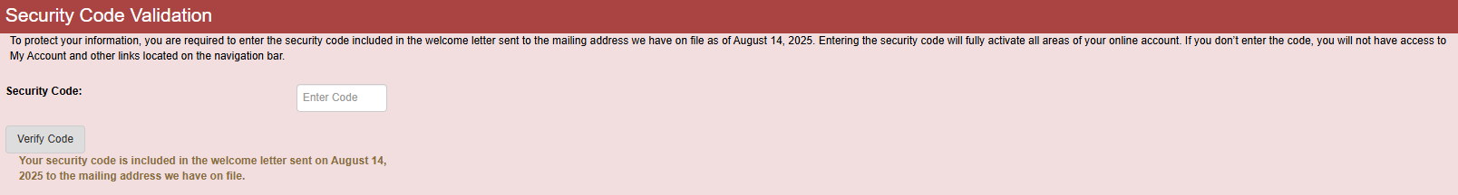
DRS First Time Account Login
Three-time verification Code Process
  Phone Number
  Email Address
  Home Address

Slide 50

Optional Savings Plan
State Board Voluntary Investment Plan 403(b)
  Pre-tax and/or after tax (Roth)
  Administered by TIAA
  Employee contribution only
Maximum contribution amount to your SBVIP under PERS, TRS, or the SBRP:
  $24,500 — If you are under age 50
  Additional $8,000 — For age 50 or over; Catch-up Contributions
  Additional $11,250 — For individuals who are age 60-63; Super Catch-up Contributions
  Additional $3,000 — For individuals with 15 years of service (one employer); Catch-up Contributions
  Call DRS at 800-547-6657 to determine eligibility.

Slide 51
Tuition Waiver
Optional Deductions
Contribute towards a child’s college tuition
  GET Program
  WA529 Invest
Shoreline Community College Foundation
  The Foundation is a non-profit organization that raises money through donations which fund a variety of merit and need-based scholarships for students at Shoreline
Can take courses at any accepted college
Faculty and Admin can access upon hire
Classified can access after 6-month probationary period
Contact hr@shoreline.edu for more information

Slide 52

Questions?
Benefits Office benefits@shoreline.edu
206-546-4510
Administration (1000) Building, Office 1015

